Slide 1
Book Club vocabulary – What the Ladybird Heard

Slide 2
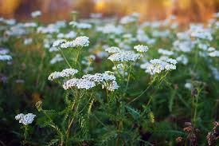
Dainty
Delicately small and pretty

Slide 3
Cunning
Getting what you want by doing something bad or wrong

