Slide 1
New Book Club vocabulary

Slide 2
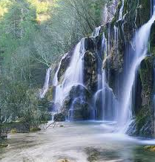
Cascades
Lots of water pouring downwards.

Slide 3
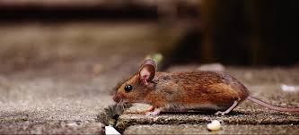
Scurry
To move in a hurry with short, quick steps.

Slide 4
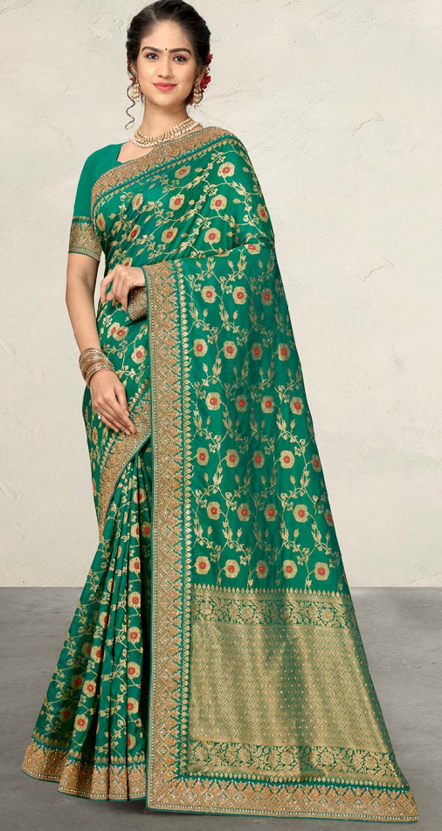
Sari
A type of clothing traditionally worn by ladies in India, Sri Lanka, Pakistan, Bangladesh and Nepal.

Slide 5
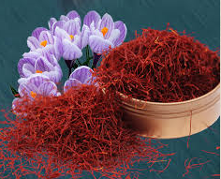
Saffron
A spice which comes from a flower known as the ‘saffron crocus’.

